Slide 1


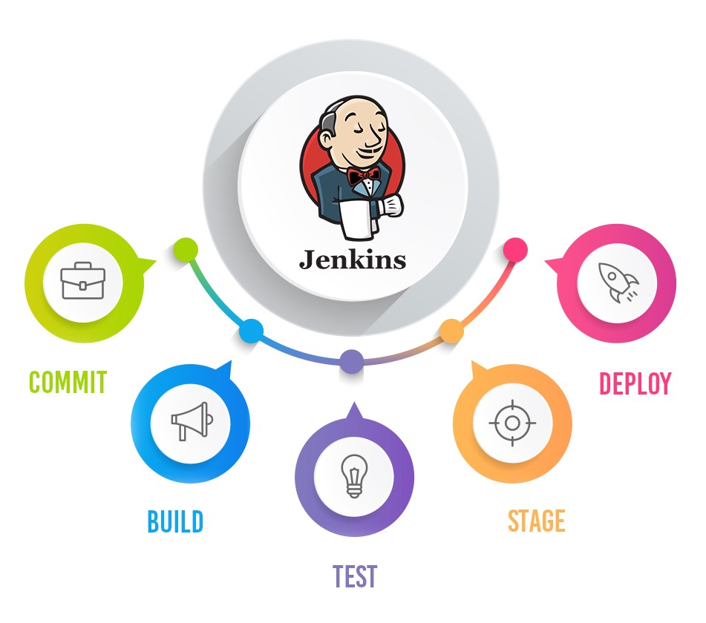
Jenkins Mastery for Software Tester
Pramod Dutta
Slack Notification of Build in Jenkins

Slide 2

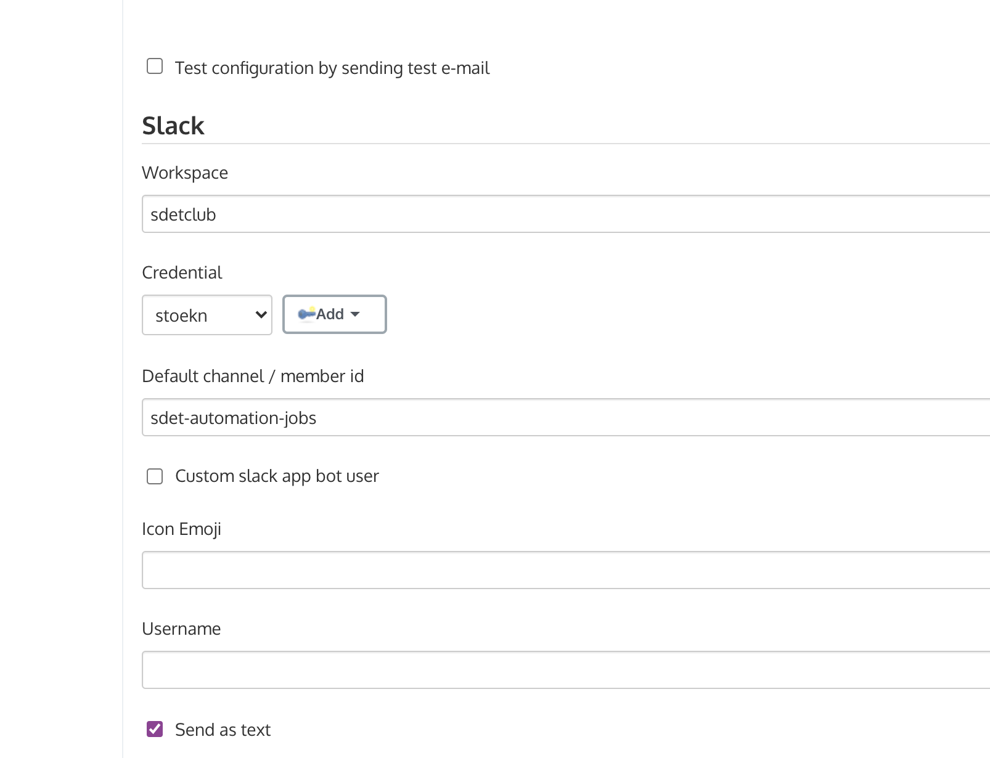
What we need to Slack Notification?
You can send the slack notification report based on failure or pass to Stakeholders
You can customize the reports.
You can attach log and HTML results
http://localhost:8080/configure
https://sdetclub.slack.com/services/2721934649698?updated=1

Slide 3
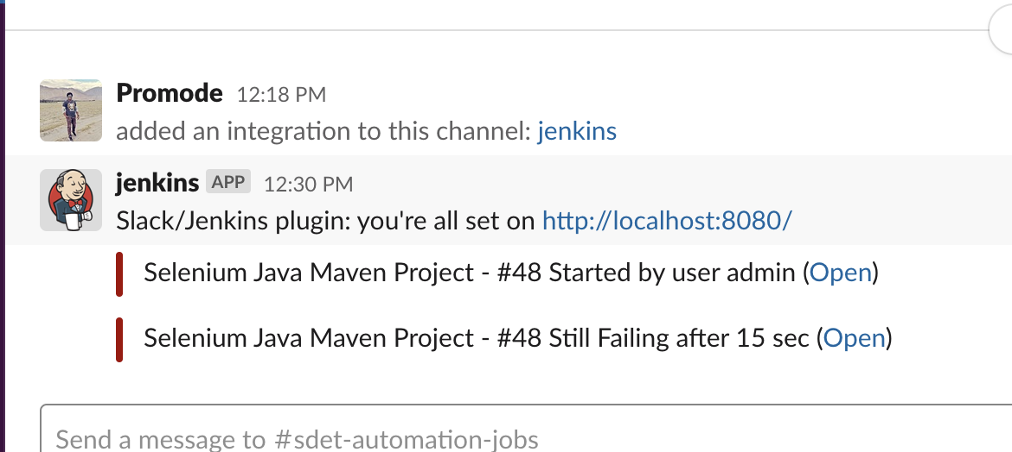
Notification with Logs on Failure.

Slide 4
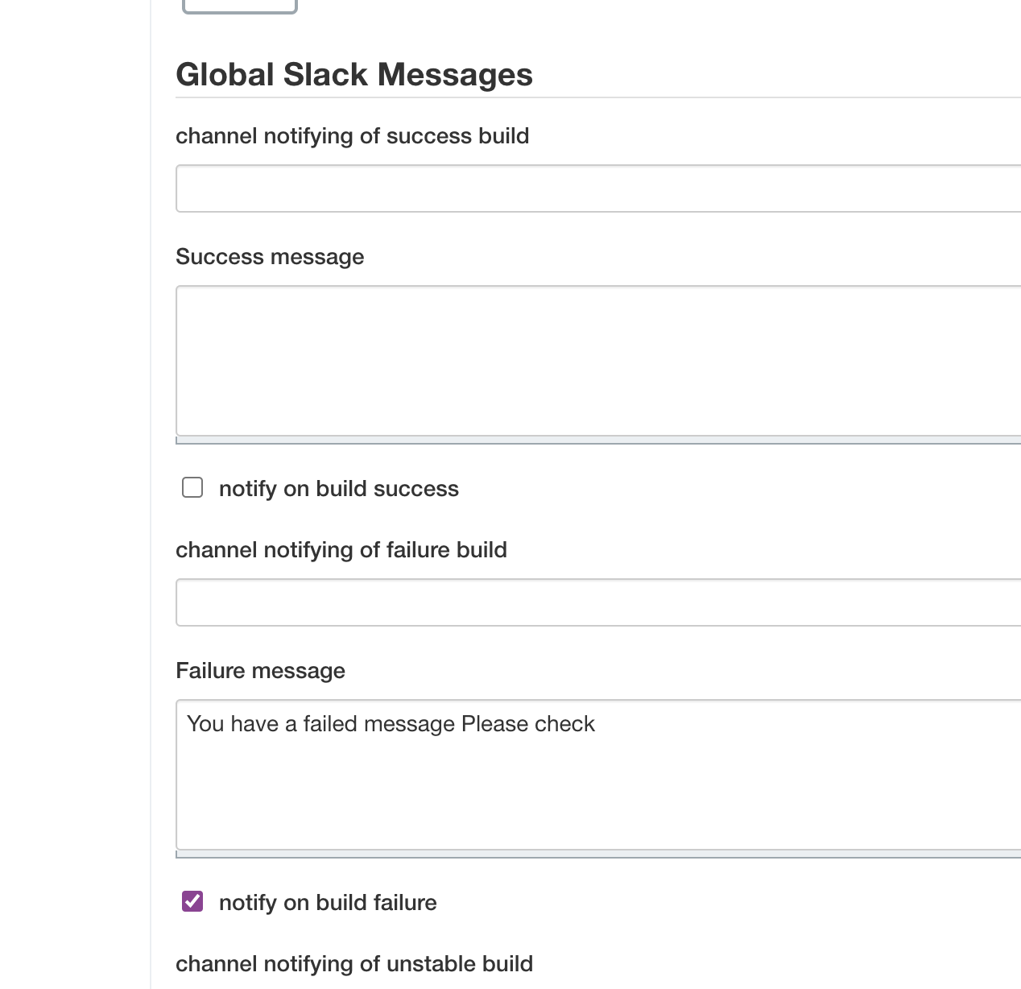
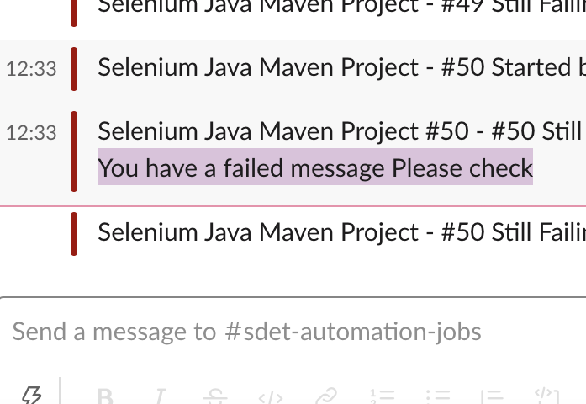
Custom notification - http://localhost:8080/configure

